Slide 1
COVID-19 Test Pick Up
Victoria Flynn, LICSW
February 28, 2022

Slide 2
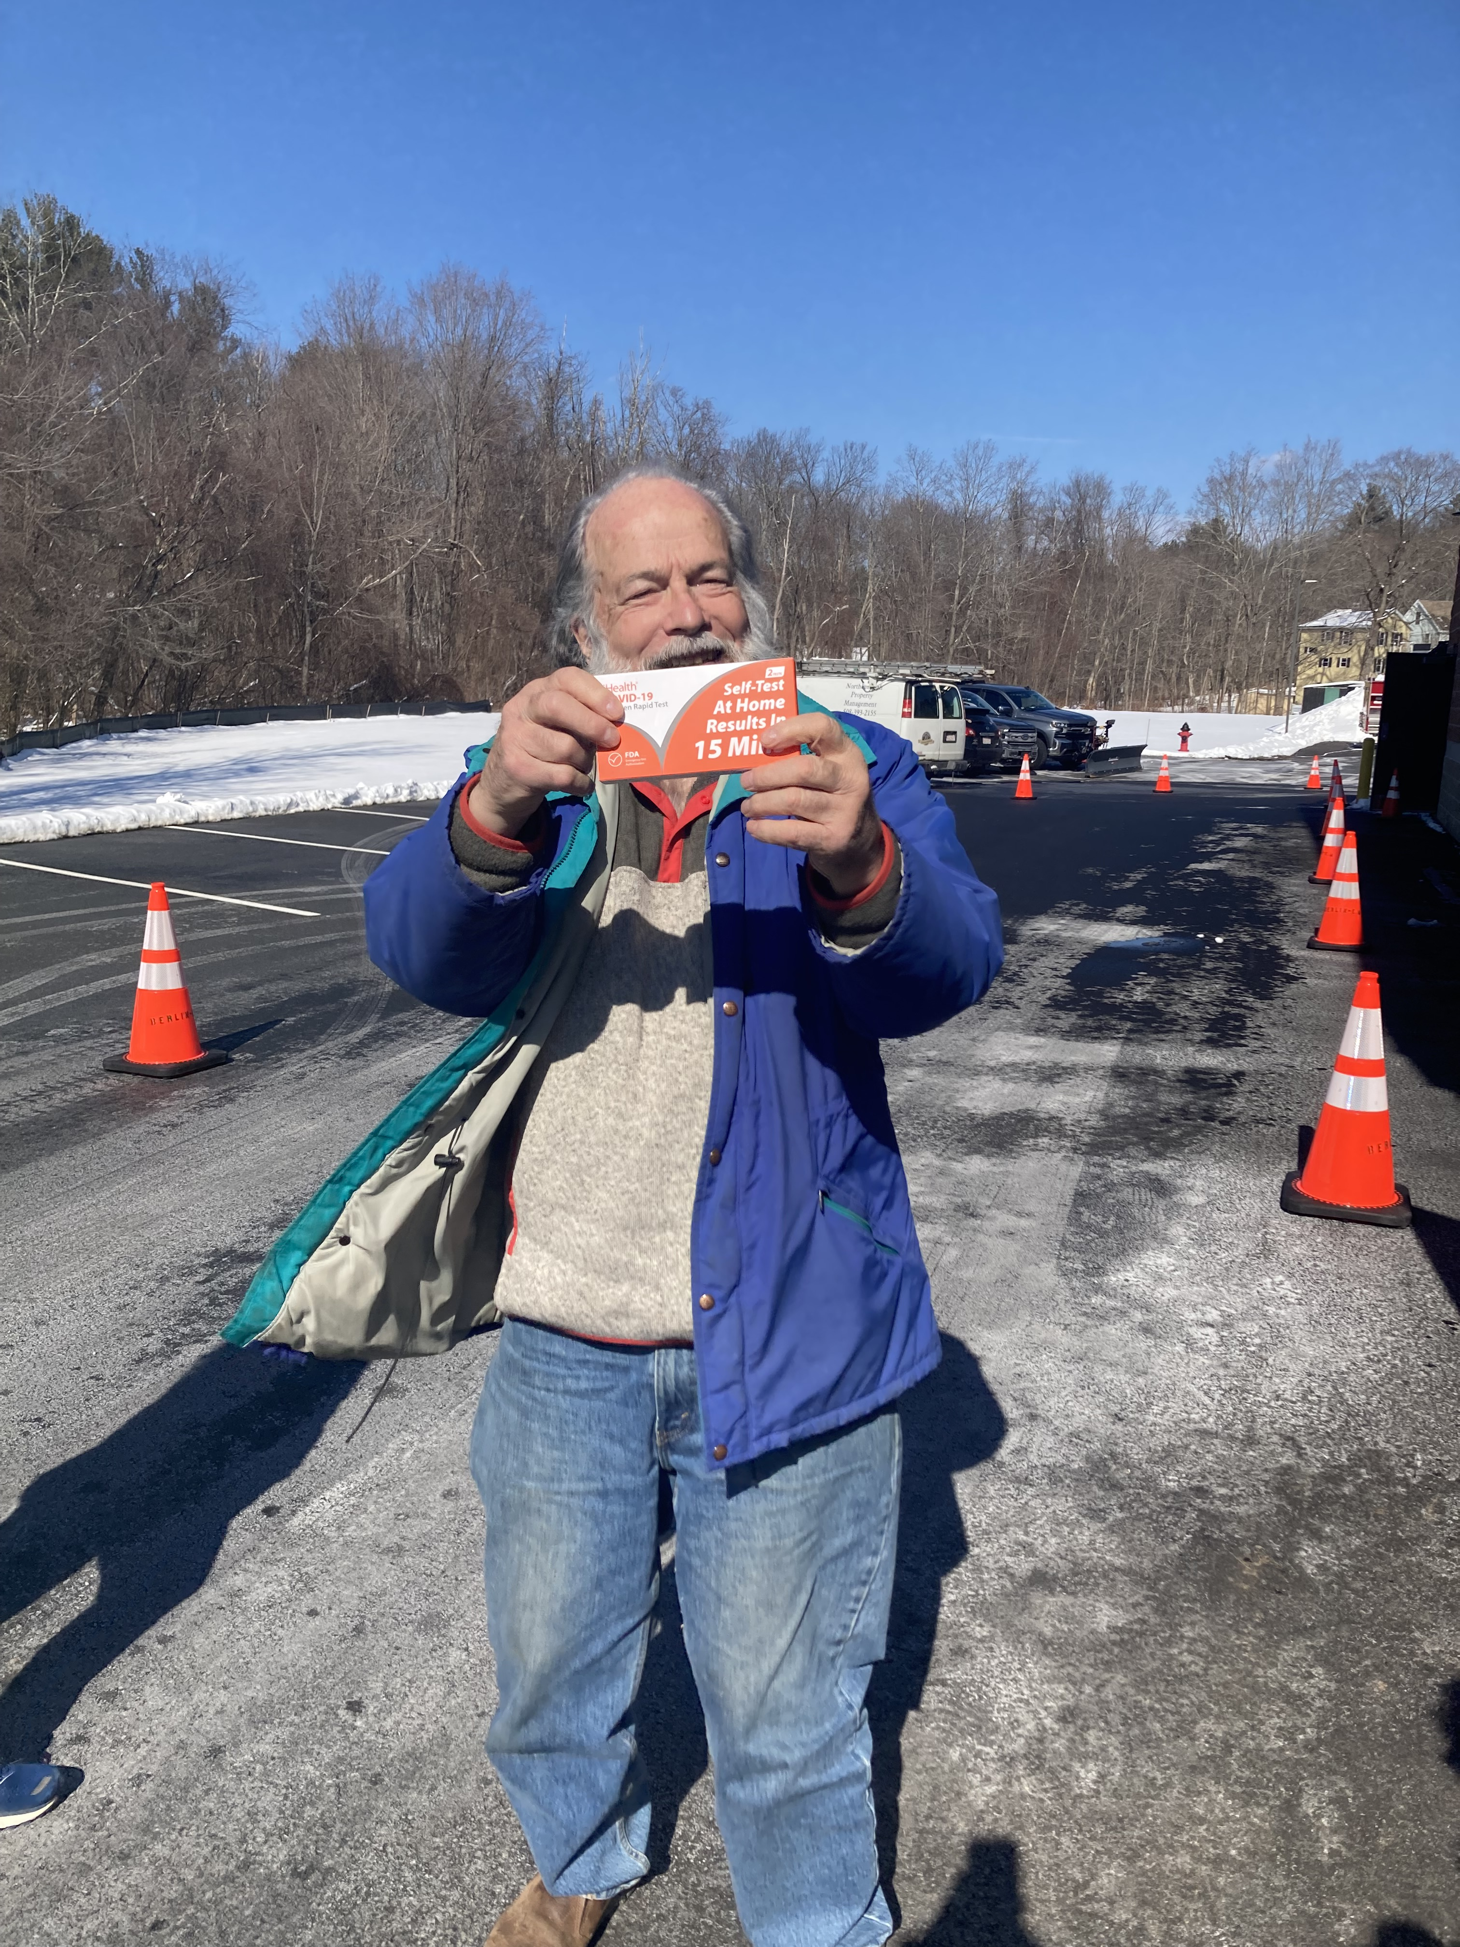
Berlin’s First COVID-19 Test Drive Thru
Sunday, February 27, 2022
Berlin Fire Station

Slide 3
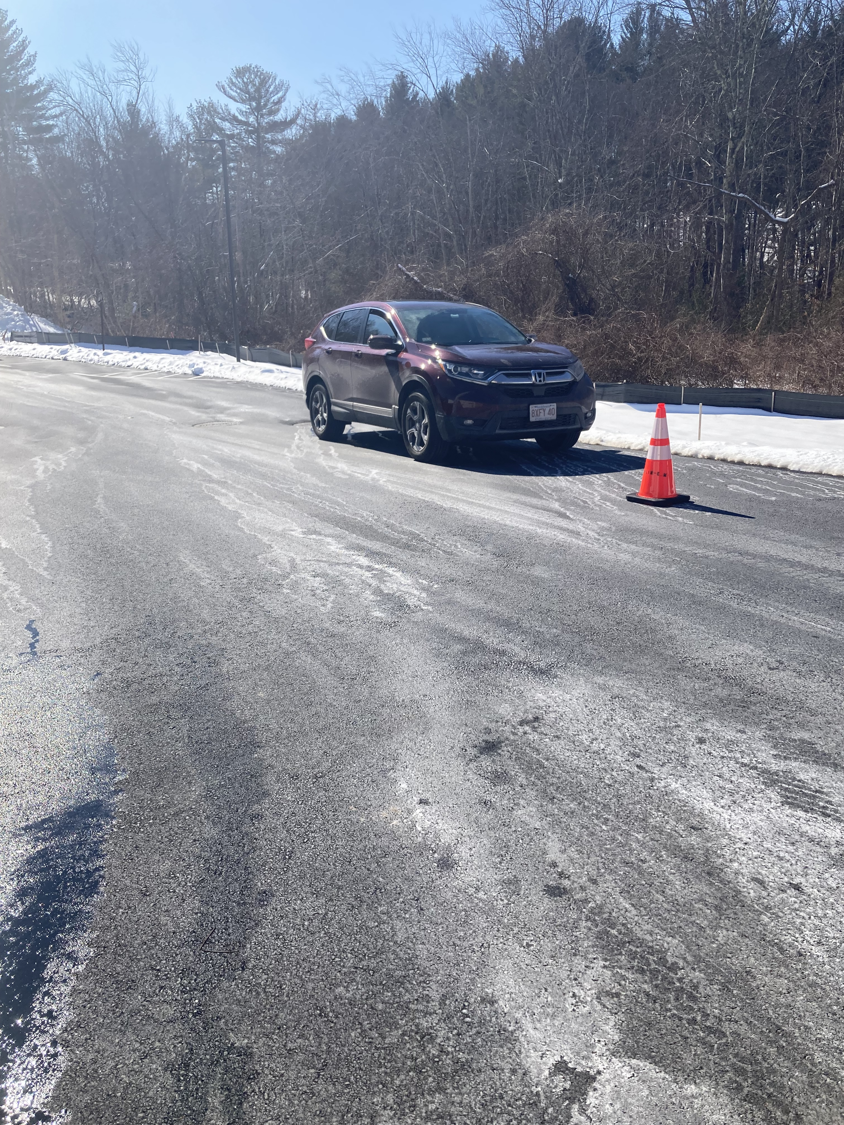
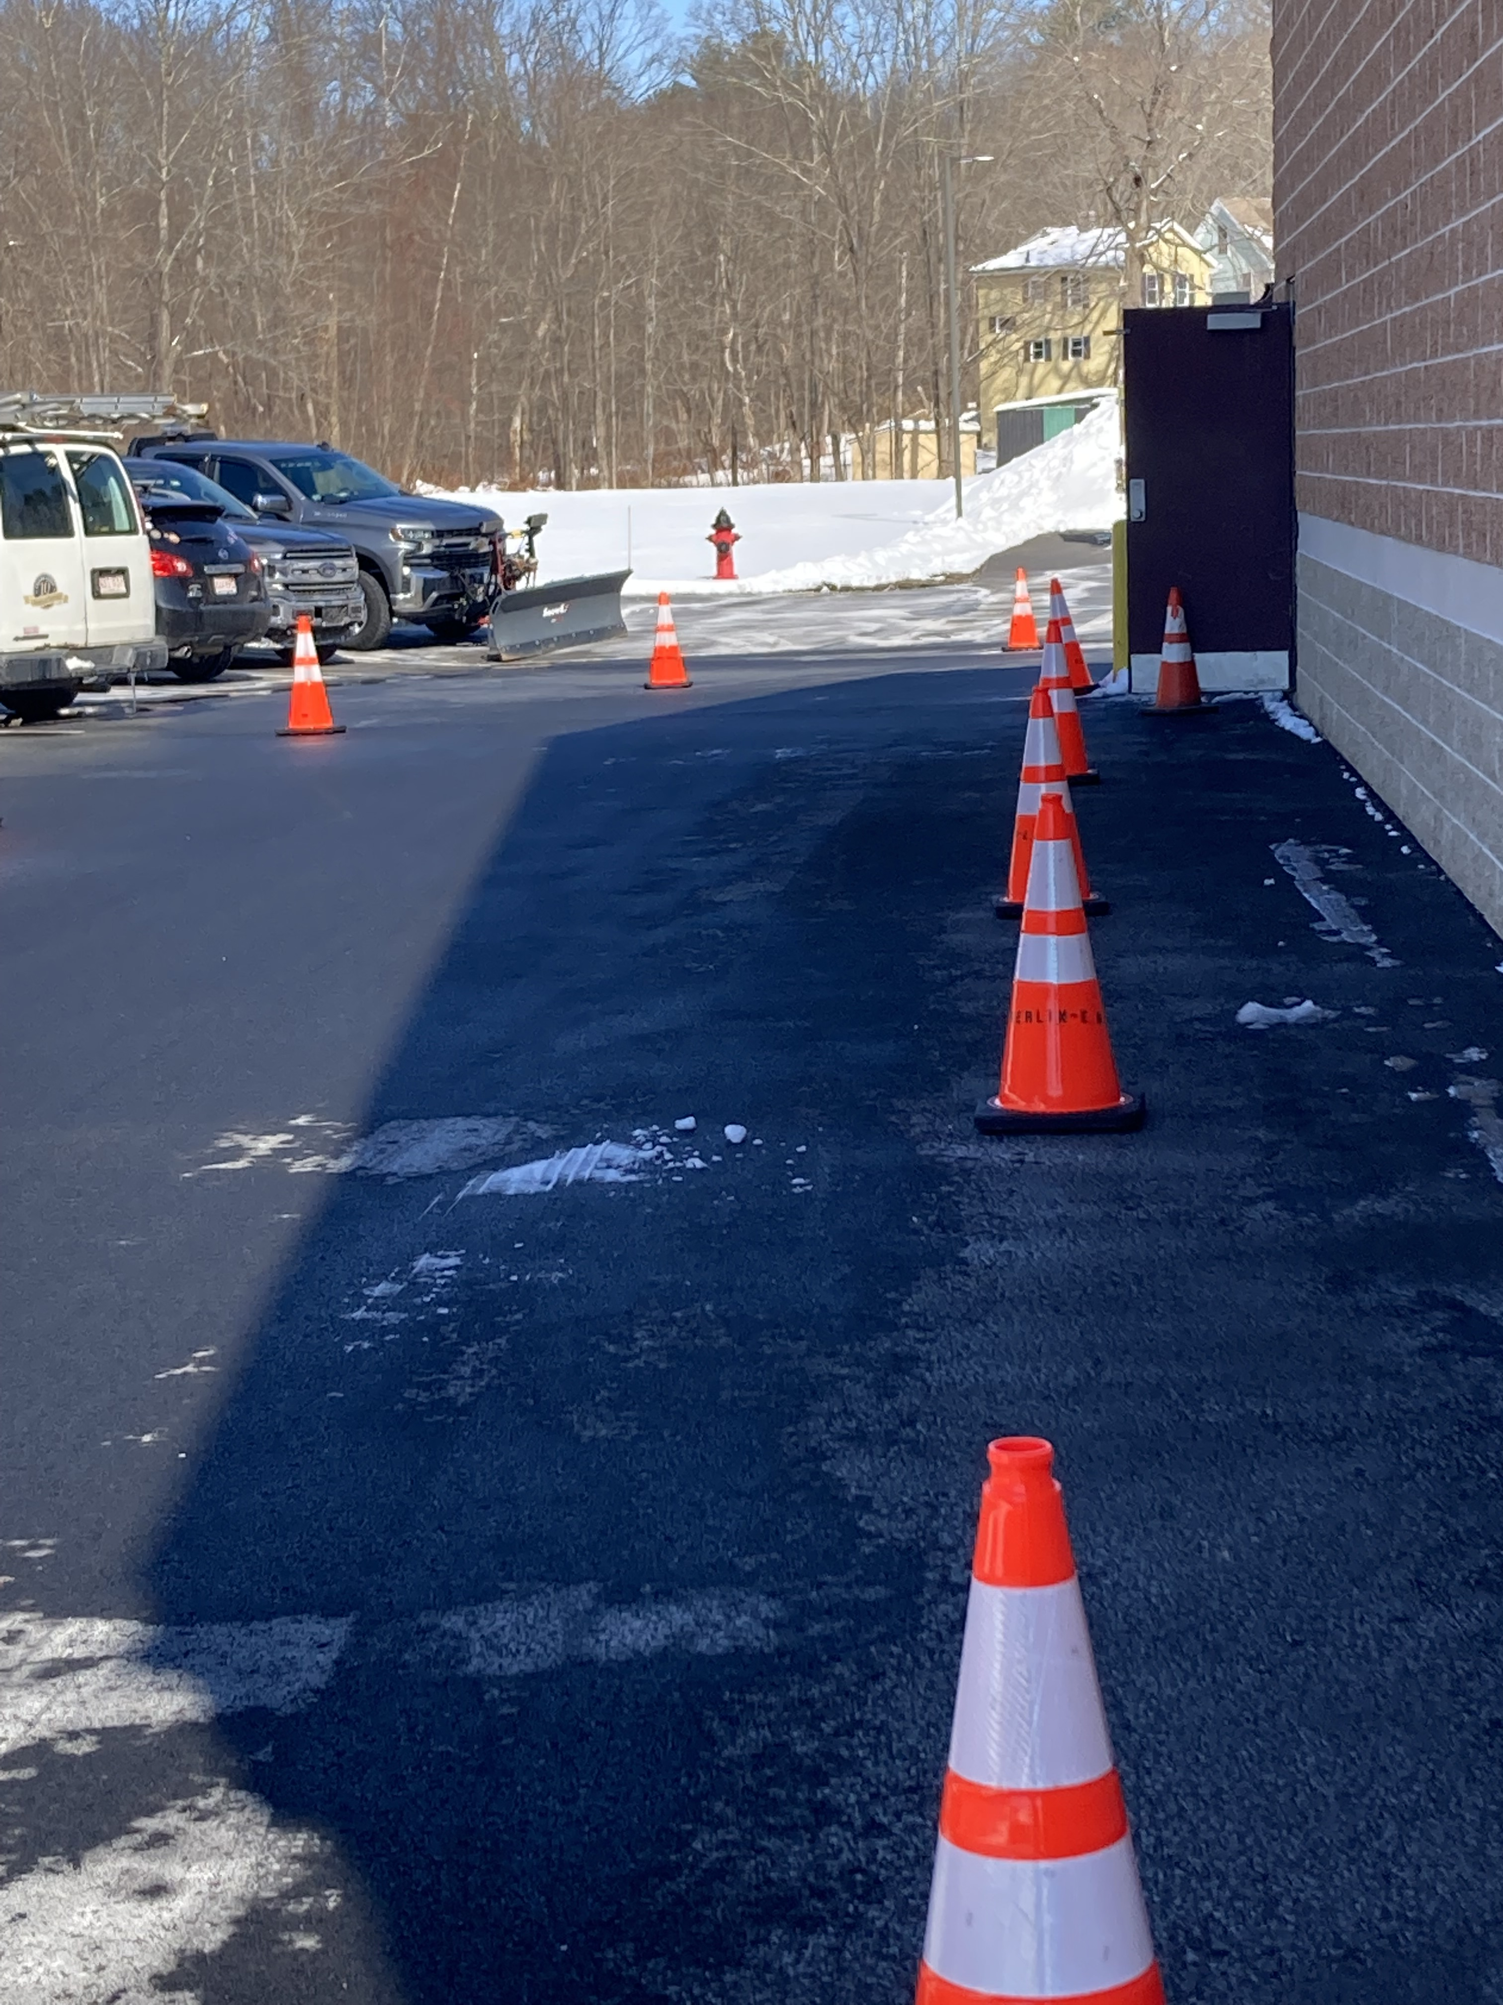
Setup--Outdoors

Slide 4
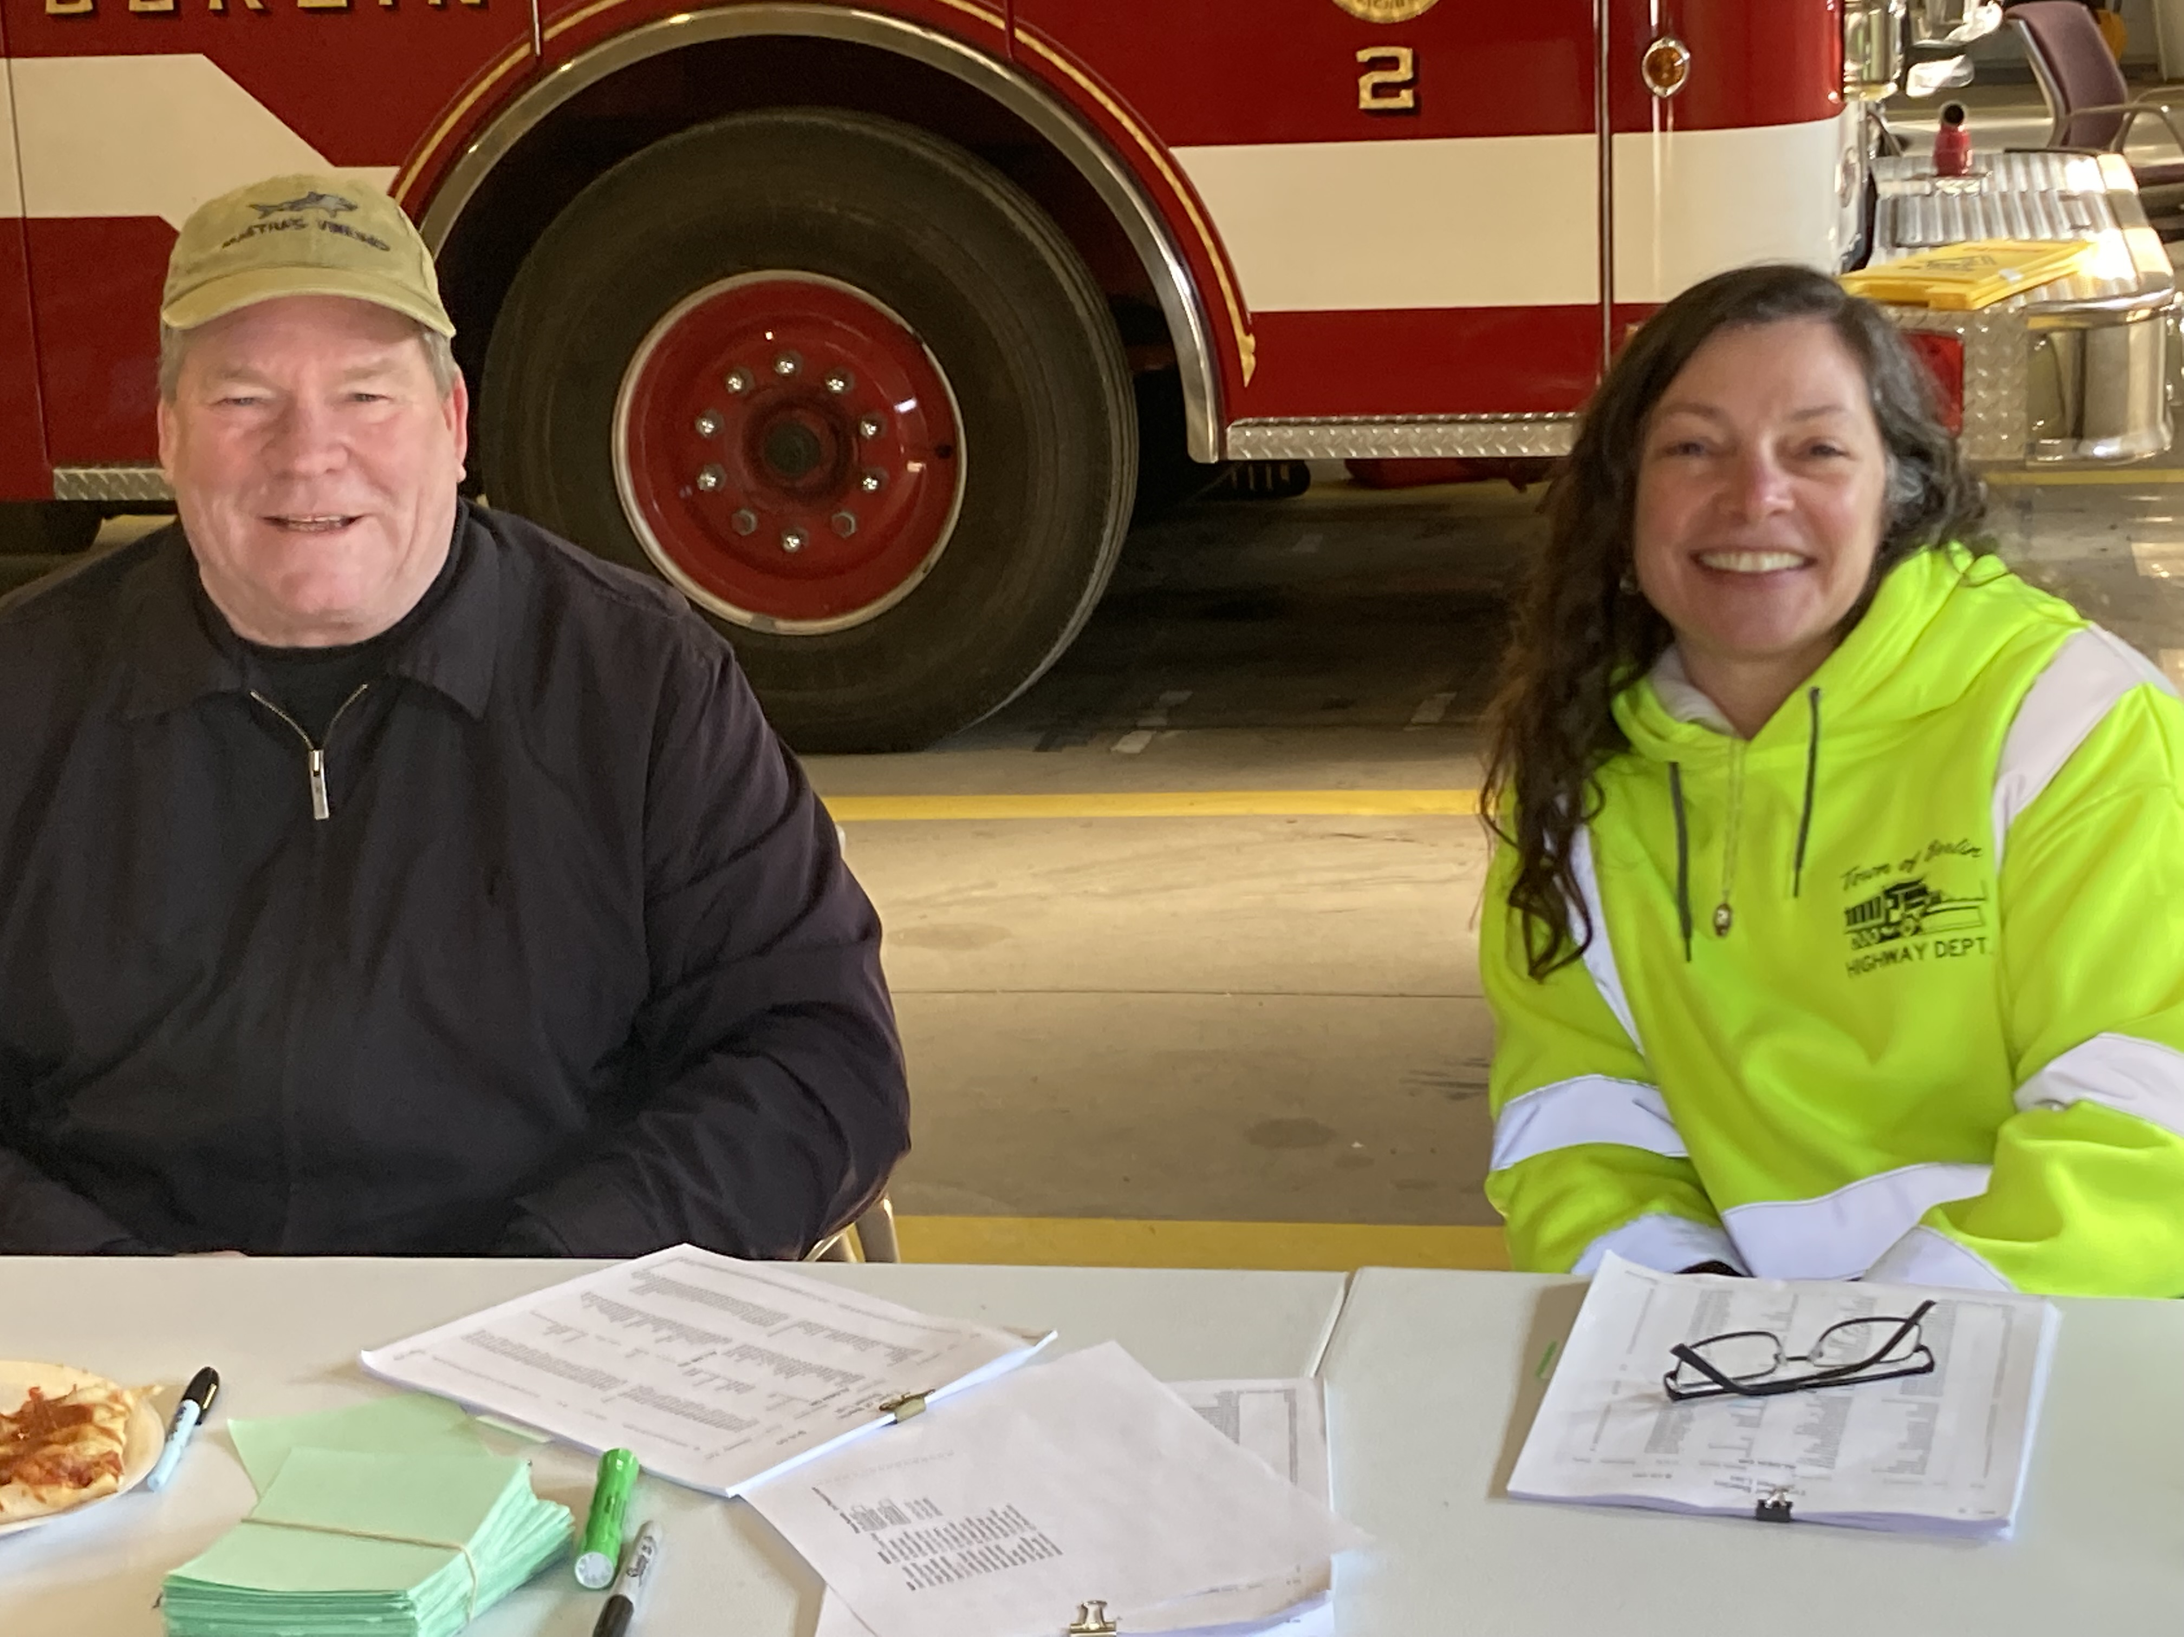
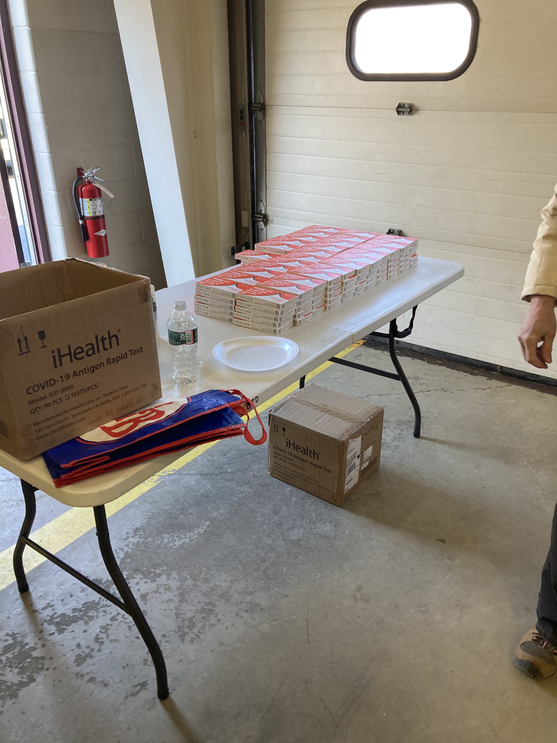
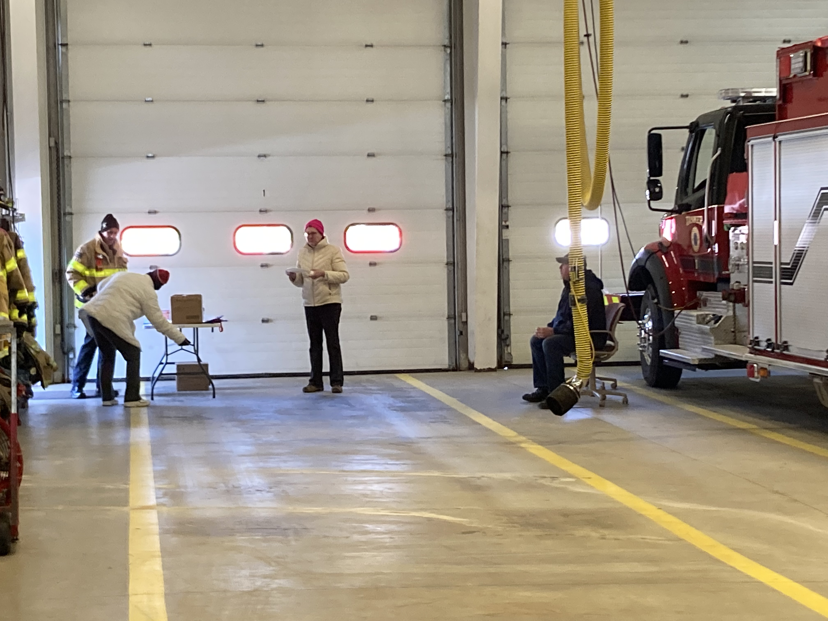
Setup--Indoors

Slide 5
Statistics
Had 361 COVID test boxes for distribution
Northbrook 1&2—distributed 83 boxes for their residents
12 families had deliveries (Bob Blair—MVDD)
44 families picked up at drive thru
Estimating 70-75 boxes total distributed Sunday

Slide 6
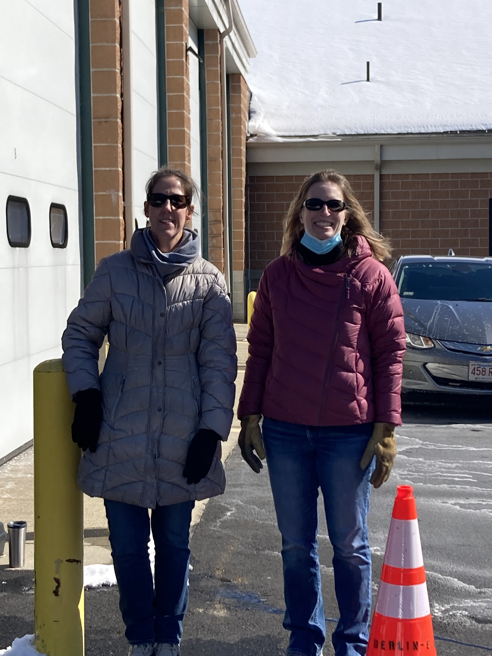
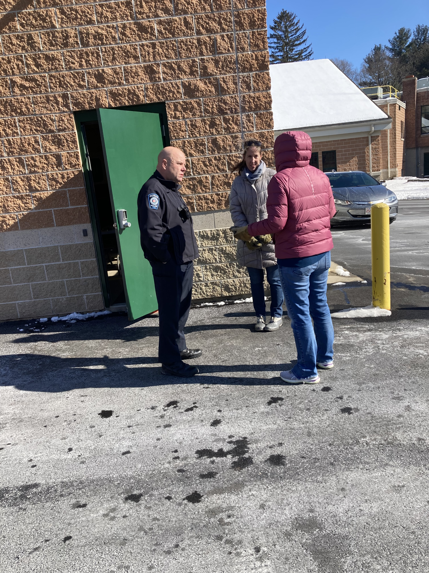
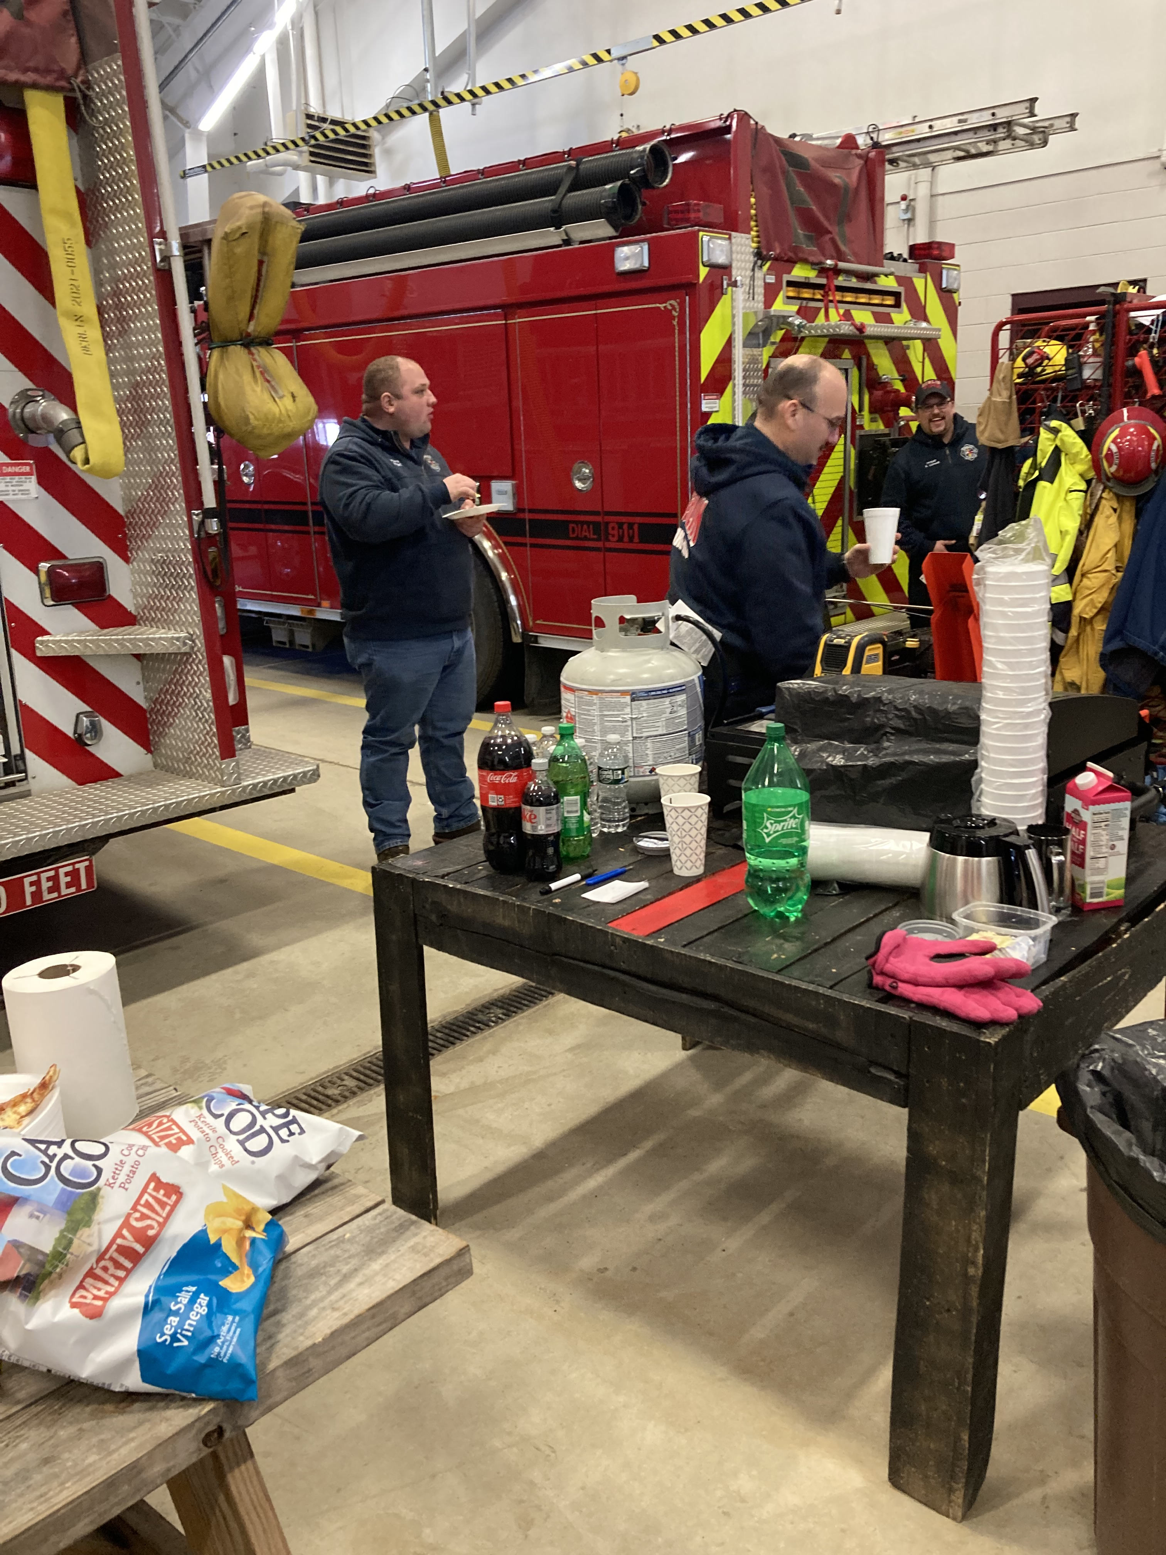

Slide 7
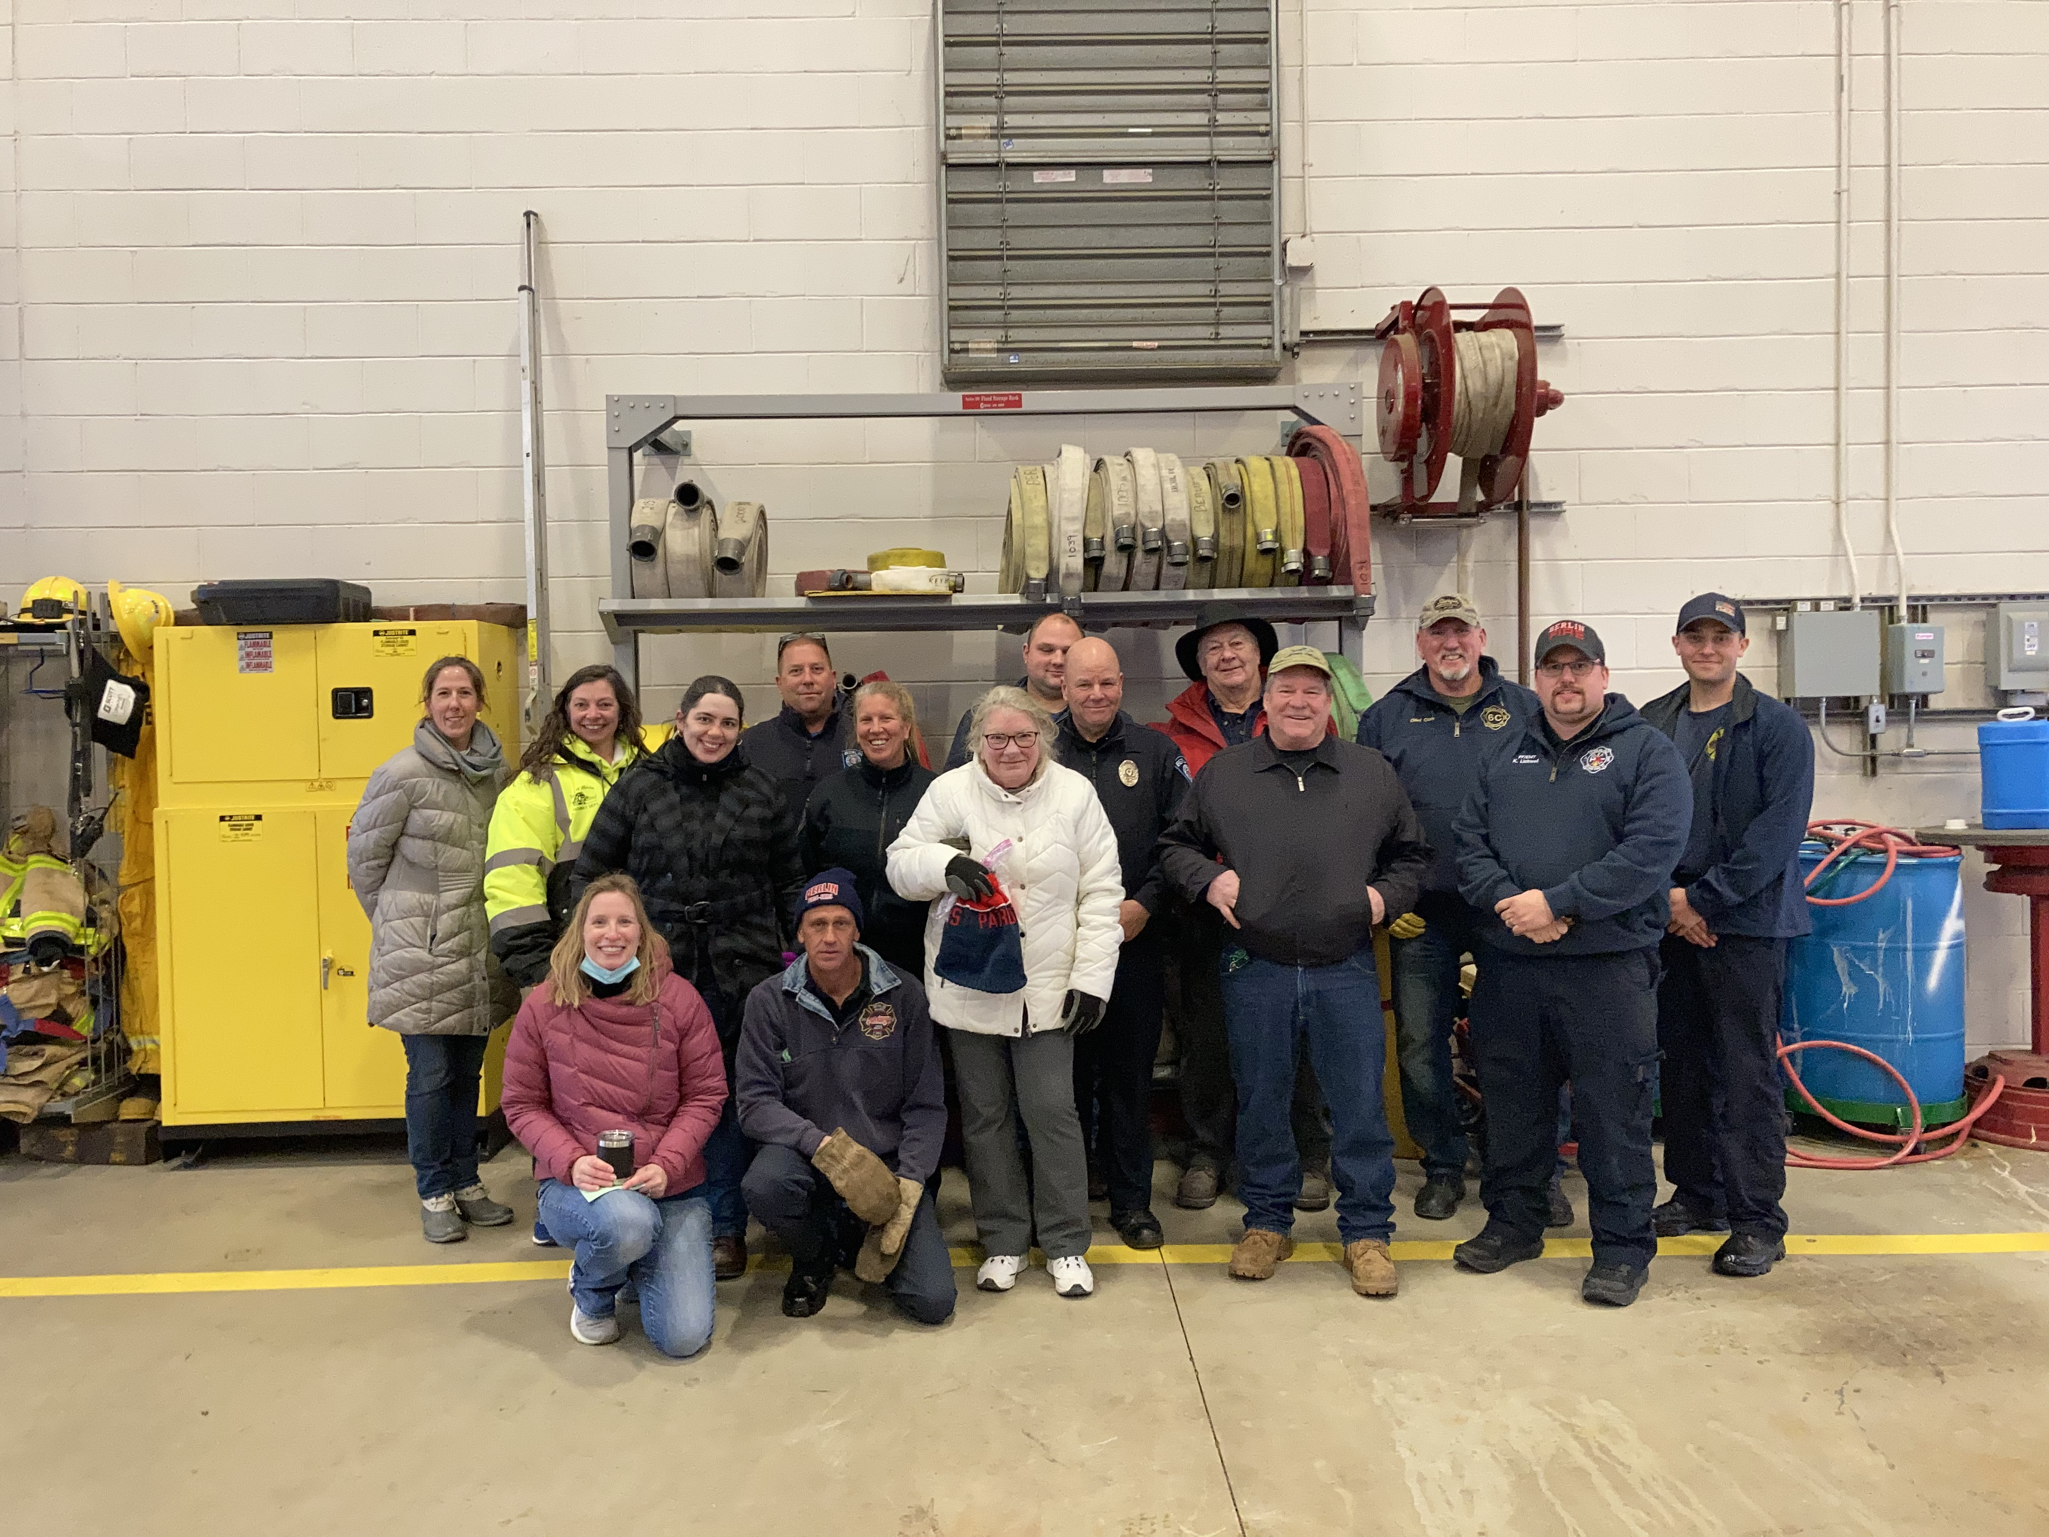

Slide 8
THANK YOUS
Board of Health—Paul Mikelk, Robert Wheeler and Susan Reguera
COA- Kate Bliss, Karen Schultz, Bob Blair
Fire Department- Chief Clark (On Duty): Michelle Deveau and Kyle Lichwell, (Off Duty) Thomas (TJ) Deptula, Peter Fortin, Jeff Cummings
Police Department- Chief Schartner, Officer Goulding, Abigail Vianna
Highway/Fire: Fred Cummings
Food Pantry-Mary Mikelk
Others: Stephanie Pitman

Slide 9
Please reach out if you are in need of more tests.
Council on Aging– 978-838-2750

